Slide 1

Number Systems
KG Microcollege

Slide 2
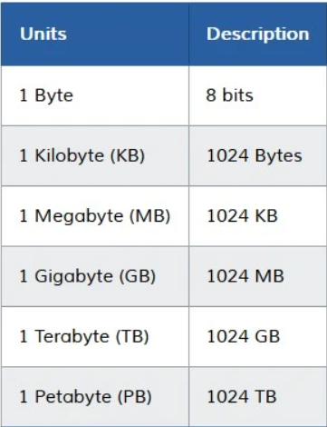
Understanding Binary
Data Representation
Data – Any Information that has to be stored is data. Ex: Text, Image, Videos, etc.
Space – Data also has size and occupies space on the storage device.
Data-Size – Space occupied by data is measured in the units of Bits and Bytes

Slide 3
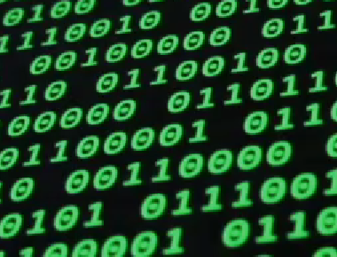
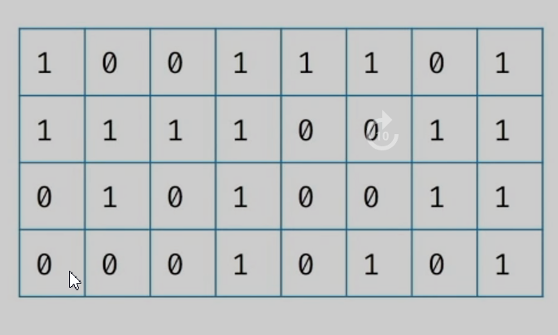
How Computer See Information
Binary – Ones (1) and Zeros (0)
A Binary number is a number expressed in Ones (1) and Zeros (0)
Binary Representation
If a number is represented using Zeros and Ones then the representation is called Binary Representation.
Each box can be considered as a Bit. It can hold either a Zero or a One.
Each bit (Binary Digit) is the basic unit of information in a computer.

Slide 4
Number Systems
A writing system for expressing numbers.
Binary Notation:
The only notation that computers understand.
Digits: 0, 1
Ex: 1101
Binary Representation:
1 X 2³ + 1 X 2² + 0 X 2¹ + 1 X 2⁰
8 + 4 + 1 = 13
Decimal Notation:
Digits: 0 – 9
Ex: 4175
Decimal Representation:
4 X 10³ + 1 X 10² + 7 X 10¹ + 5 X 10⁰ = 4175
Radix/Base:
The number of unique symbols or digits used to represent numbers in that notation is called the Base.
Decimal Notation Has Base: 10
Binary Notation Has Base: 2

Slide 5
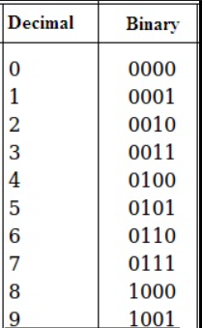
Counting Numbers In Binary

Slide 6
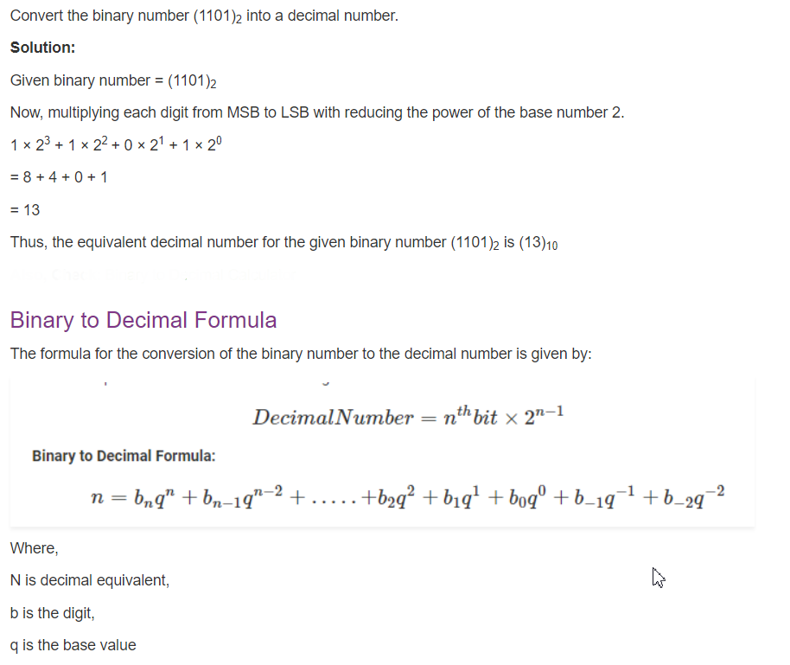
Steps to Convert Binary to Decimal:

Slide 7
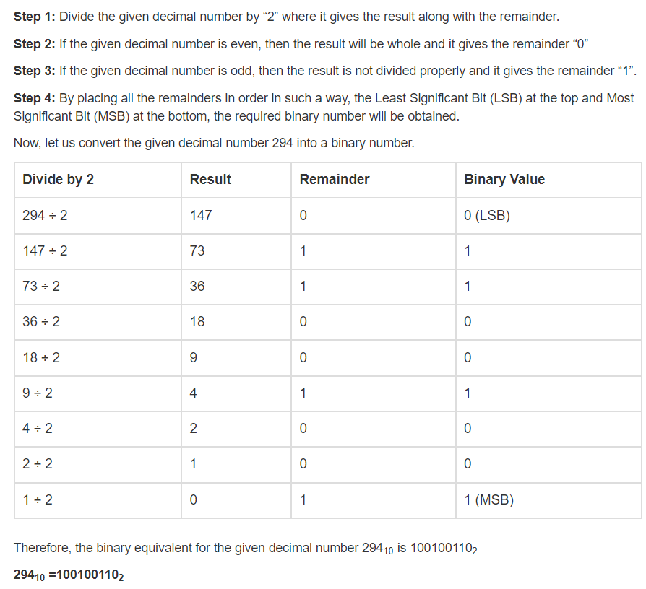
Steps to Convert Decimal to Binary:

Slide 8
Decimal To Binary Conversion
Base | Num | Rem
2 | 13
2 | 6 | 1
2 | 3 | 0
2 | 1 | 1
 | 0 | 1
13(10) = 1101(2)

Slide 9
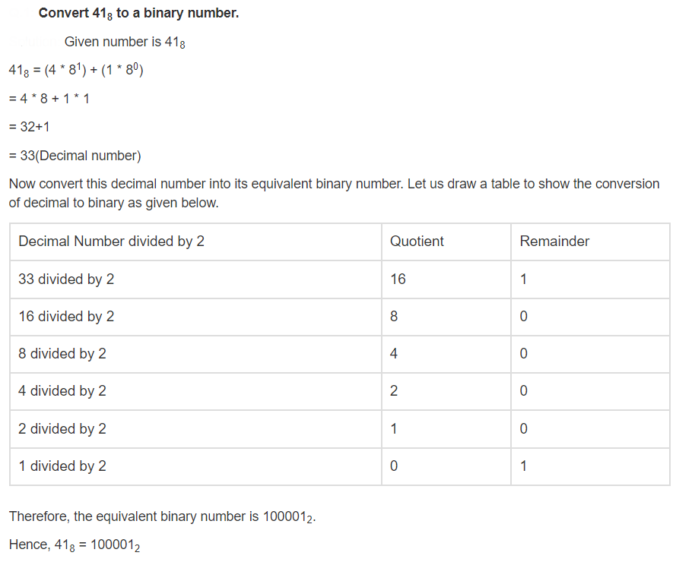
Steps to Convert Octal to Binary:

Slide 10
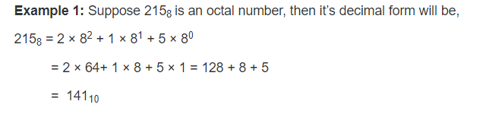
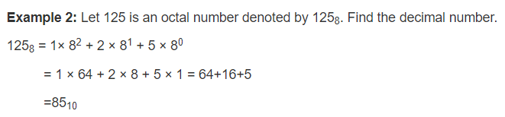
Steps to Convert Octal to Decimal:

Slide 11
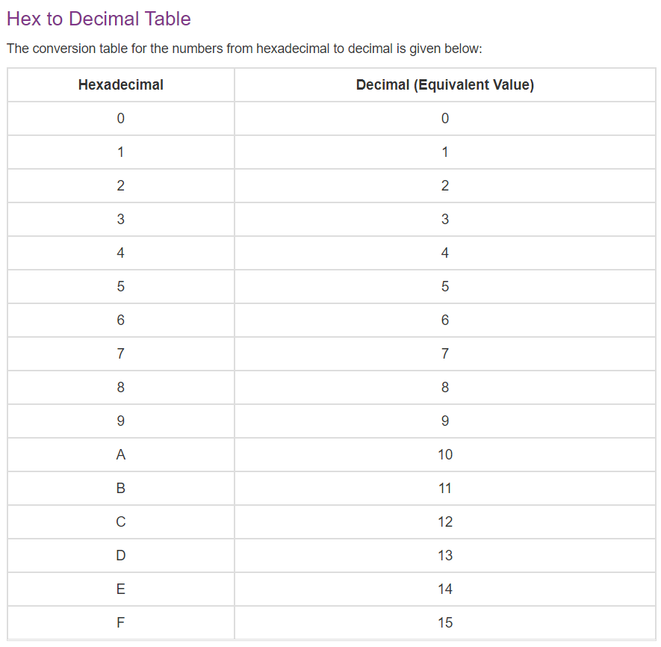

Slide 12
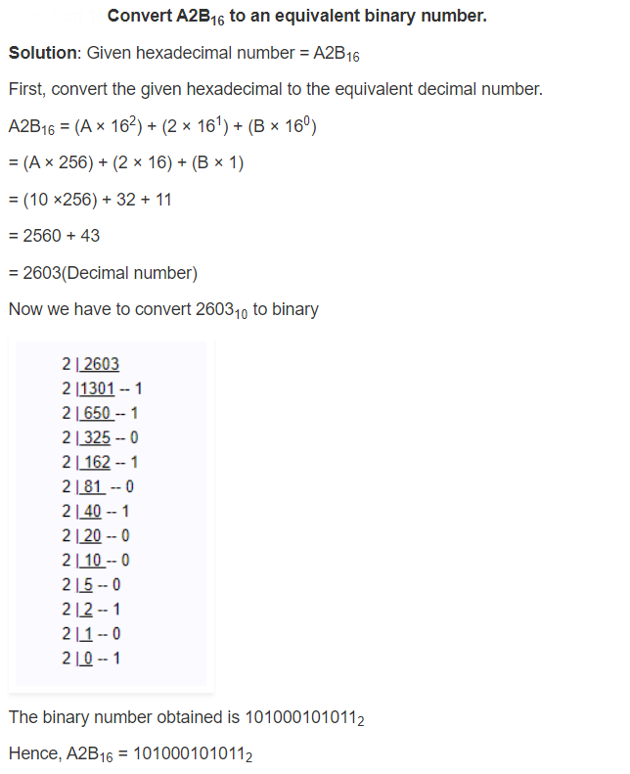
Steps to Convert Hex to Binary:

Slide 13
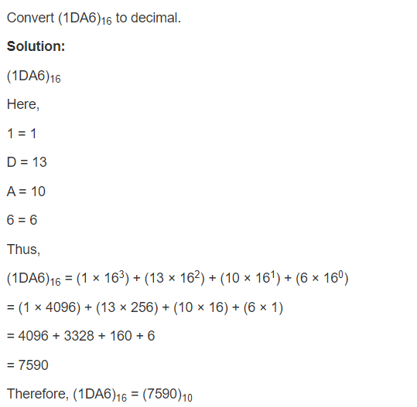
Steps to Convert Hex to Decimal:

Slide 14
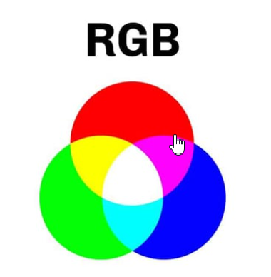
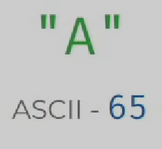
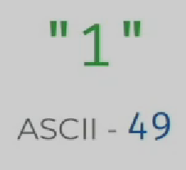
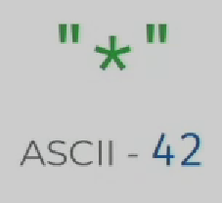
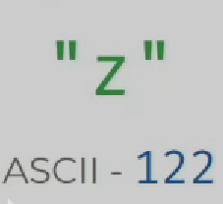
Binary Representation Of Images
Each Image has pixels. Each Pixel has a specific color.
Can use RGB model to represent colors.
Binary Representation Of Text
Each character is encoded as an integer which is represented by a binary value.
ASCII:
American Standard Code for Information Interchange(ASCII).
Represents the English alphabet, digits, and punctuation marks.
Requires only one byte to store a character.

Slide 15
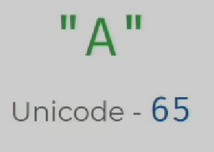
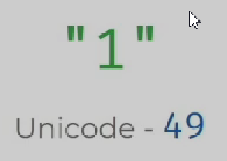
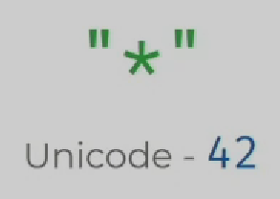
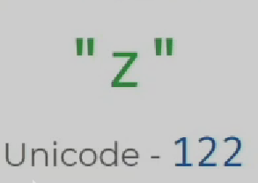
Unicode
A byte can only represent 256 different things.
Limit on No.of.Characters that can be represented.
Unicode allows us represent characters using more than 1 byte.
UTF-8
UTF-8 (Unicode Transformation Format – 8).
Capable of storing 1, 112, 064 different characters.
Has same values for ASCII characters.

Slide 16
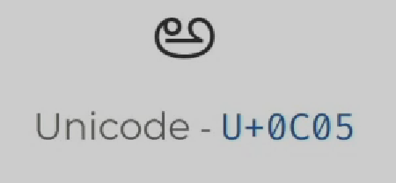
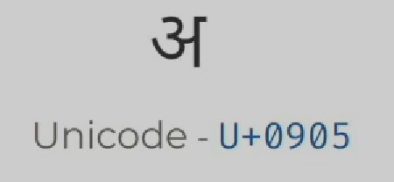
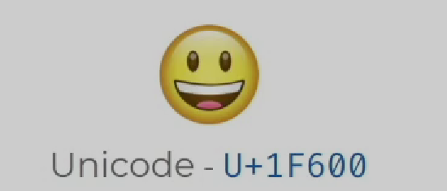

Slide 17
Key Takeaways
Data Representation
Binary & Decimal Number Systems
Conversion between Binary & Decimal
Representing Images
Pixels & RGB Colors
Representing Text
ASCII & UTF-8

